Slide 1
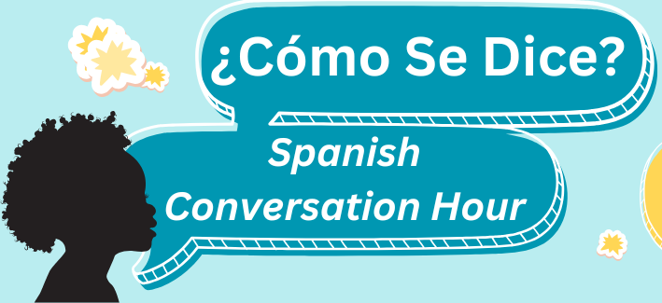


Slide 2
Meet Our Facilitators
Yesenia Lopez
Luisa Martucci
Nelida Vazquez

Slide 3
What we won’t learn here:
Complex Grammar
Advanced Vocabulary
Fluent conversation skills
Every colloquial expression for every dialect of Spanish

Slide 4
What we will learn here:
Basic conversational phrases
Essential Grammar for everyday situations
Variations in pronunciation or slang used in different Spanish-speaking countries.
Cultural insights

Slide 5
Spanish Language: Things to Know
Spanish is the majority language in 21 countries, and a commonly used language in many more
Many dialects, accents, and variations in vocabulary
“Spanglish” can make for even more variation

Slide 6
Getting Started:
Introduction of ourselves in Spanish
Spanish alphabet practice- Tips
Review Technology Vocab List
Listen and comprehend phrases
Practice in small groups

Slide 7
INTRODUCTION:
Hola, me llamo ________________
(Hi, my name is ________________)
Trabajo en ____________________
(I work at _____________________)
Mi color favorito es _________________
(my favorite color is_________________)

Slide 8
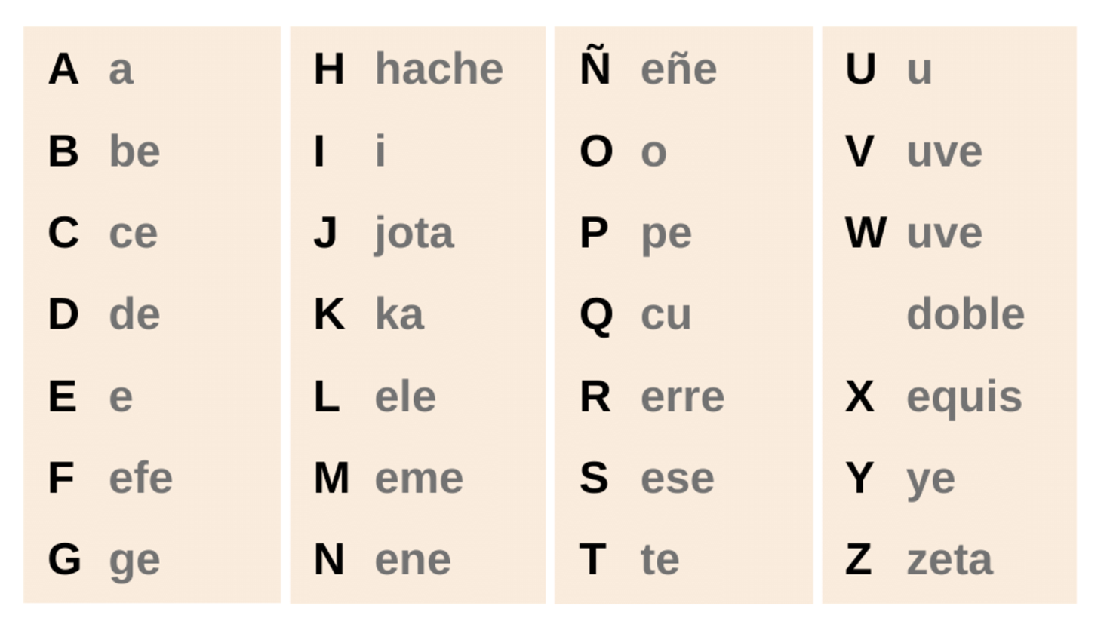
Pronouncing the Spanish Alphabet
Notes:
Warm up pronouncuation

Slide 9
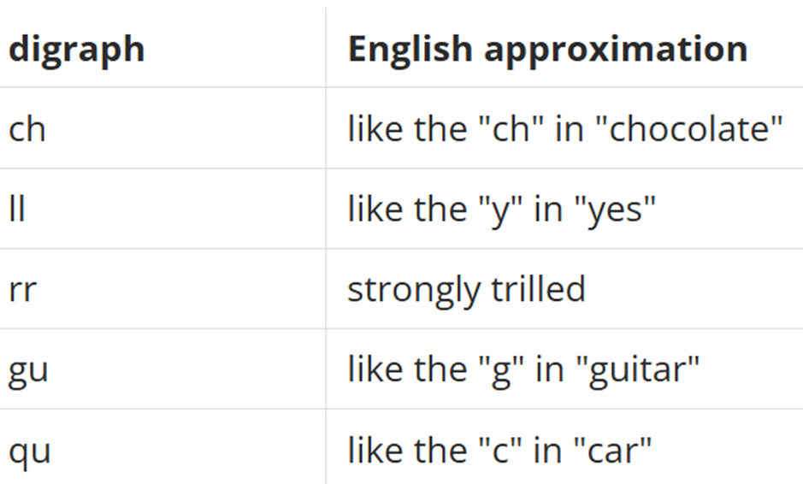
Pronunciation Tips:
Diagraf
Ch ( che) = chao (bye)
LL ( elle) = llave (key)
rr (erre) = carro (car)
Gu (geu) = gustar (like)
Qu (ku) = queso (cheese)
Notes:
Warm up pronouncuation

Slide 10
Vocabulary List 6: Technology
I will first present the pronunciation.
Participants will have the opportunity to pronounce the Spanish vocabulary
We will practice vocabulary through the Matamoscas / Fly swatter game.
Notes:
Explain better

Slide 11
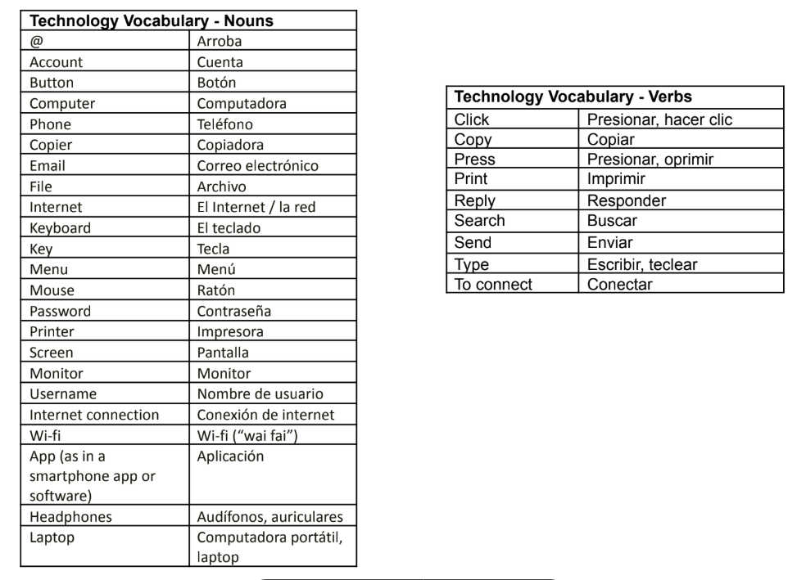
Vocabulary List 6
Technology I
Nouns
Notes:
Add phrases?

Slide 12
Technology Vocabulary practice I
Matamoscas / Fly swatter
Pantalla
Monitor
Correo electrónico
Botón
Arroba
Computadora portátil,
Aplicación
Teléfono
Copiadora
Audífonos, auriculares
Tecla
teclado
Nombre de usuario
Contraseña
Menú
Computadora
Ratón
Cuenta
Wi-fi
Impresora
Conexión de internet
Internet / red
Archivo

Slide 13
Vocabulary List 6
Technology II
Verbs
Notes:
Add phrases?

Slide 14
Technology Vocabulary practice II
Matamoscas / Fly swatter
hacer clic
Imprimir
Responder
Presionar, oprimir
Enviar
Escribir, teclear
Buscar
Copiar
Conectar
Notes:
Add phrases?

Slide 15
Phrases: Technology Vocabulary
I will first present the pronunciation of phrases
Participants will have the opportunity to pronounce the Spanish vocabulary in their own.
I will play a conversation happening at the library using technology vocabulary.
Notes:
Explain better

Slide 16
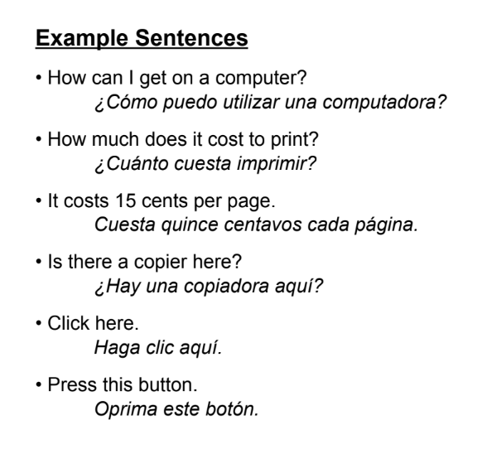
Technology Phrases

Slide 17
Technology Phrases
Hello, can I ask for help with the computer?
Hola, ¿puedo pedir ayuda con la computadora?
I'm having problems with the internet connection.
Tengo problemas con la conexión a internet.
Of course! Please restart the computer.
¡Claro que sí! Por favor reinicie el computador?
Could you help me print?
¿Podrías ayudarme a imprimir?
Of course! Go to the left menu and click File, then print.
¡Claro que sí! Vaya al menu izquierdo y haga clic en imprimir.

Slide 18

Technology Vocabulary use
​ Please pay attention to the dialogue that takes place in the computer section of the library, and complete the lines in small groups.

Slide 19
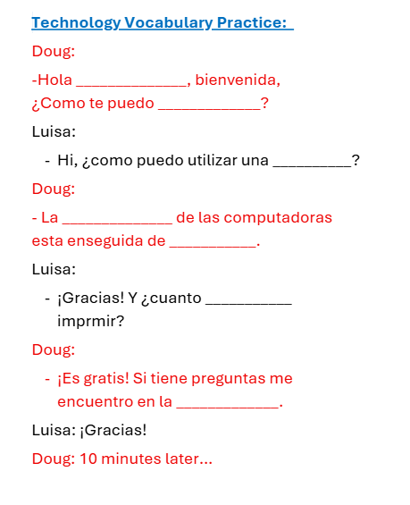
Technology vocabulary practice

Slide 20

Questions?

Slide 21
Practice: Role Playing
Participants will be divided into groups of 3 to 4 people, and you will have 15 minutes to practice
We will visit each room and answer questions.
Share the practice with the whole group.

Slide 22
¡Gracias!

