Slide 4
The #1 pick (highest number of votes) gets a “Favorite” badge on the website. Beginning in October 2018 and going forward, books #2-10 are listed in alphabetical order and should be considered of equal popularity by librarians.

Slide 5
New for 2018: Hall of Fame Authors
Based on feedback from our users, the Steering Committee decided to create the LibraryReads Hall of Fame designation for favorite authors who appear frequently on the monthly lists. This opens up space for newer and midlist authors, while still giving praise and recognition to those perennially popular authors.
A Hall of Fame author’s title that reaches the votes to make the list does still appear on the list featured on the website, receives additional social media mentions, and is featured in the Hall of Fame section of the LibraryReads website.

Slide 6
Why Should YOU Participate in LibraryReads?
To increase your familiarity with publishers
To increase your awareness of new books
To enhance your readers’ advisory skills
To improve patron experience by connecting readers to great new reads
Anyone working in a public library in the US can vote via your NetGalley or Edelweiss account. You vote after receiving digital or paper ARCs via these two services, from conference events, or from publisher mailings.

Slide 7
How do I nominate titles for LibraryReads?
Are you regularly employed by a U.S. public library? Then you can nominate titles for LibraryReads!
Whichever ten books get the most nominations go onto the monthly list. The book with the most nominations becomes the #1 Pick. It’s as simple as that! Books from all adult genres and categories are welcome. We encourage you to read and suggest titles and authors that reflect the diversity of your own communities.
Our nomination deadlines are ONE MONTH ahead of publication, so you will need to read books in advance of publication in physical or digital formats. These digital advance reading copies (or ARCs) are available via Edelweiss and NetGalley, which are also the two platforms for nominating titles. Both services are free for library staff to register and use. Paper ARCs or galleys are often made available, and can also be used.

Slide 8
Nominate titles via Edelweiss
If you are already an Edelweiss user and registered as working for a public library, you are all set! You are already a LibraryReads member. When looking at a book you’d like to nominate while logged into Edelweiss, click on the speech balloon at the left bottom side to “Rate and/or Review This Title.” After rating or reviewing, click “Submit To” in the upper right hand corner, and select LibraryReads from the drop down menu. You may also want to share your review with the Publisher.
If you are not an Edelweiss user, please register for Edelweiss using the Organization Type “Library – Public” to join the LibraryReads community.
Nominate titles via NetGalley
If you are already a NetGalley member, you are already a LibraryReads member. You may nominate any of your approved titles via the “Feedback” button on the Title Details page. Be sure to edit your profile to identify yourself as a public library employee, or your vote won’t count.
If you’re not yet a member of NetGalley, you may register at www.netgalley.com. You will be able to request digital galleys and be invited to view new titles. Be sure to edit your profile to identify yourself as a public library employee, or your vote won’t count.

Slide 11
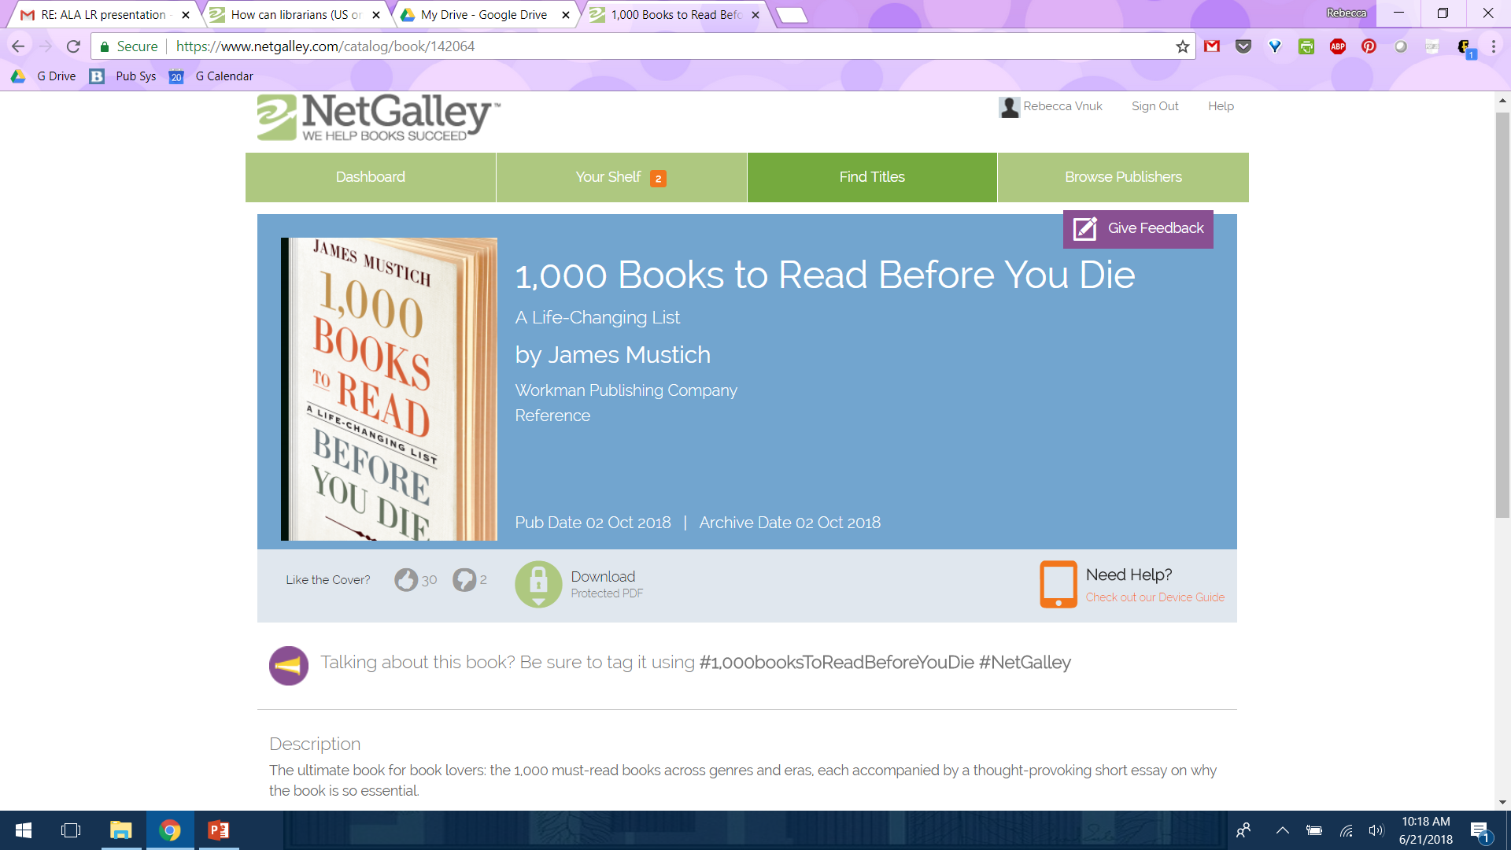

Slide 12
LibraryReads Annotations
You can TOTALLY place your vote without an annotation/review, but we encourage you to submit one if you can! You could be featured in the next list! (And don’t worry! We edit them HEAVILY--with your approval--beforehand!)
280 character limit
Appeal terms woven in
Think of what sort of reader would enjoy this book, and describe it so that they can find it. What is special about this book? To what other authors or experiences might you compare it? - Read-alikes encouraged!
Write conversationally, as though you were talking about a favorite title with a patron or colleague at the library, or with a friend. Use your own voice.

Slide 13
Using LibraryReads
Collection Development
Check list against your orders to add more great books to the collection
Readers’ Advisory
10 more books you can pretend you’ve read!
Book groups
Many LR blurbs point out book group choices
Social media
Extra content for FB, Twitter, Instagram, tumblr

Slide 14
LibraryReads in the Library:
Collection Merchandising
Print out the list from the website
Use the lists for displays
Write up shelf-talkers

Slide 15
What’s Ahead for LibraryReads?
More robust annotations featuring readalike titles (when possible) chosen by professional readers’ advisory librarians.
Additional lists, including Steering Committee picks, book group selections, themed lists, and more.
A new user-friendly website coming soon, giving everyone more access to our expanded content.
FREE training opportunities via online webinar partnership with NoveList AND MORE!

Slide 16
Any Questions?
Please feel free to contact
Rebecca Vnuk, Executive Director, at Rebecca@libraryreads.org!

