Slide 1
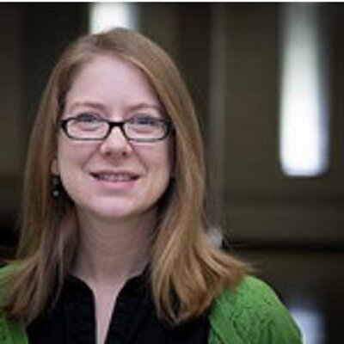
Internet Famous: Strategically Marketing Your Special Collections Online
Colleen Theisen
Outreach & Instruction Librarian
Special Collections & Archives
University of Iowa
colleen-theisen@uiowa.edu
@libralthinking
Notes:
Design this slide

Slide 2
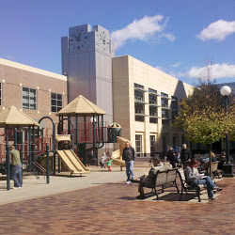
Notes:
The University of Iowa is located in Iowa City, IA.
Large research university with an Undergraduate enrollment of 22,354
Fun public library
Located within the United States’ only UNESCO designated City of Literature
Writer’s workshop, International writers program, Center for the Book.
The building you see is the original territorial capitol of Iowa, now a museum and the building at the heart of campus.

Slide 3
What kind of library/institution do you work for?
Notes:
Poll: What kind of library/institution do you work for?
Public Library
Academic Library
Special Collections
Archives
These categories aren’t good enough! Ask Sophie

Slide 4
Special Collections & Iowa Women’s Archives
Librarian
Graduate Assistant
Staff
Student worker
Notes:
Reality: I started this on my own. But I am surrounded by a large department, who gradually got excited and got involved, so that the team you see here is participating.
However, most are managing a single on feed on their own.
It is realistic to keep up on one feed by yourself, if you enjoy it, but it is easy to burn out.

Slide 5
University of Iowa Social Media Network
@uispeccoll
Notes:
It actually looks something like this.
You can see our network, of content on Tumblr, being shared to Tumblr, and Tumblr posts being shared elsewhere.
UISPecColl – Center
Next tier:
IWA
UIMapColl
HevelinCollection
Iowa City Past
Next tier:
Rita Benton Music Library
Archaeology
Natural History
UICB
The Main Library
UISpecColl – Colleen, Laura Lindsay, Kelly, Jillian
UIMapColl – Margaret, whom you see in the Vine Videos.
HevelinCollection – Pete & Laura
Iowa City Past – Not in our deparment, collab with Wendy from digitized versions of archives photos + ICPL
My job? I do not do the other Tumblrs. I am the arrows. I coordinate all of it. I am video production and some editing.

Slide 6
Which Social Media Site Has Your Strongest Institutional Presence?
Notes:
Facebook
Twitter
Instagram
Tumblr
YouTube
Other
None Yet

Slide 7
Getting Started
You
Collections
Audience
1. What social media do you enjoy?
2. Where is your audience?
3. Where do the subjects of your collections best fit?
*
Notes:
Goals: Who do you want to talk to?
If your audience is elsewhere, watch that site for a while until you start to understand and enjoy it.
If you don’t enjoy it, you will burn out. Find someone else to coordinate and do the part you enjoy.
What kinds of collections do you have? Undergrads - Tumblr – home of SF related fandom, younger people, unique people – SF collections. We wanted to be able to talk about our SF collections. Home of feminism – good fit for IWA.
Campus is on Twitter and Instagram.

Slide 8
What Social Media Site Should We Use?

Slide 9
Facebook
What’s Working?
Largest population of users
Most staff have familiarity
Video
Challenges?
Algorithm
Payment
Notes:
Statistic
Algorithym.
Embed video – book reviews. Read out banned books. Keep it short. 1-3 minutes. Interview a patron about what they love about the library.
Have your employees like right away and share to their own pages.
Collaborate with other institutions for likes.

Slide 10
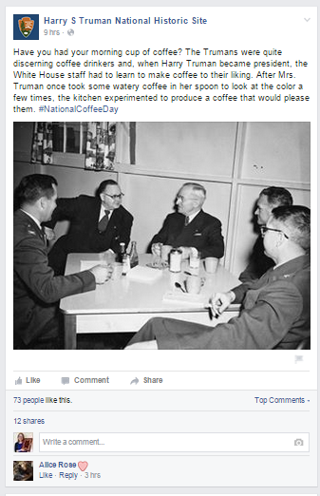
Site
Notes:
Who to Follow/Steal this idea
Harry S Truman National Historic
Wake Forest University Library

Slide 11
Twitter
What’s working?
Connecting to local institutions
Images & multimedia
Strong book/librarian community
Challenges?
Local announcements
Posts can get lost in the noise

Slide 12
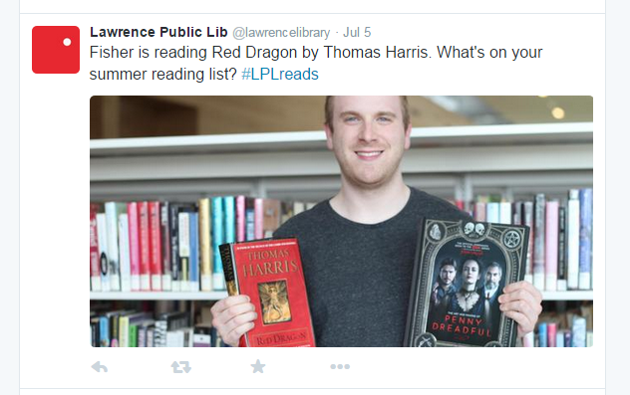
Steal This Idea: Photos In Posts
Lawrence Public Library: @lawrencelibrary
St. Louis University Libraries: @PiusLibrary
Notes:
Lawrence Public Library and Pius Library
One way – dull. Like and reblog.
Feature staff, feature local artists, feature events. Book reviews. If this, then this. Services. Weather. Where in the building?
This day in history, image posts
Try: Tweeting 4x
Try: Photos
Try: Connecting with Periscope.

Slide 13
Who to Follow:
Brooklyn Public Library
@brooklynology
Notes:
Sense of local identity through current and historic images

Slide 14
Instagram
What’s working?
Less frequent/Beautiful posts
Hashtag communities
Younger Audience
Challenges?
Mobile only
Doesn’t share well on Twitter
Staff may be less familiar
Notes:
#readersofIC (Iowa City public library staff members and what they are reading)
#librariesofinstagram
#typetuesday (fonts, handwriting, etc.)
#bookporn
#uiowa
#libraryselfie or #libraryshelfie (selfie in the stacks)
#bookfacefriday
#tbt
#marbledmonday
#manuscriptmonday
#morbidmonday (usually done by the medical museums, shows something creepy/morbid)
#caturday (Saturday post featuring cats)
#bookguts
#frankenbooks (books sewn together or repaired with yarn, other homemade stuff)
#accidentalbookmarks (stuff found in books)
#cardcatalogfriday

Slide 15
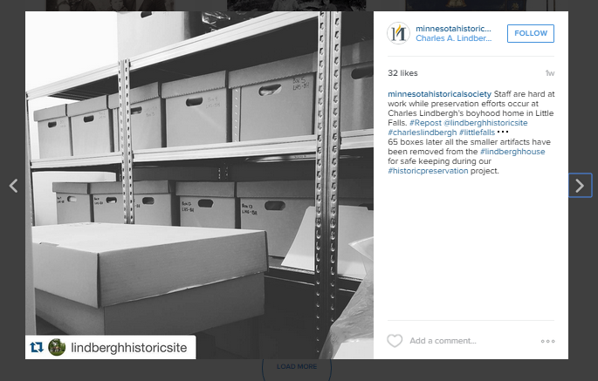
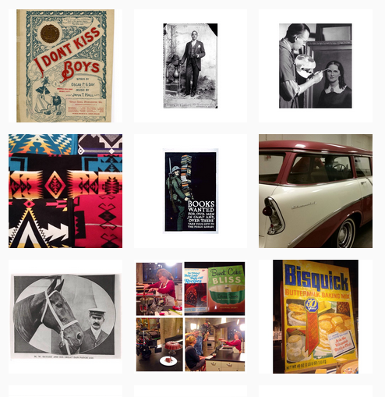
Who to Follow: Minnesota Historical Society
https://instagram.com/minnesotahistoricalsociety/
Notes:
Not too much black and white.
Mix up historic photos with real objects, people, your building, have a variety. All black and white photos can look very dull.
Talk to other collections – need an app like re-gram.

Slide 16
Tumblr
What’s Working?
Esoteric topics
Animated GIFs
Content in any form from most sites
Challenges?
Smaller market share
Conversations
Notes:
Topic based. Therefore, esoteric collection topics can find a niche.
Othmeralia.

Slide 17
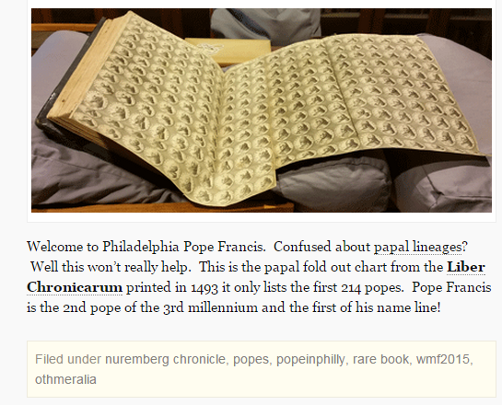
Who to Follow/Steal this idea
http://othmeralia.tumblr.com/
Notes:
Othermeralia – one staff member.
Clear voice.
Sudden national audience for a very small place.

Slide 18
YouTube
What’s working?
Series content posted on schedule
Educational video
Collaboration with other channels
Sharing with other sites
Challenges?
Time, talent, & editing
Notes:
Channel, not storage
#2 Search Engine
Events, Book reviews, but feature people.
ICPL staff picks.
Book reviews.
If you loved this, read this.
Support booktubers at your library.

Slide 19
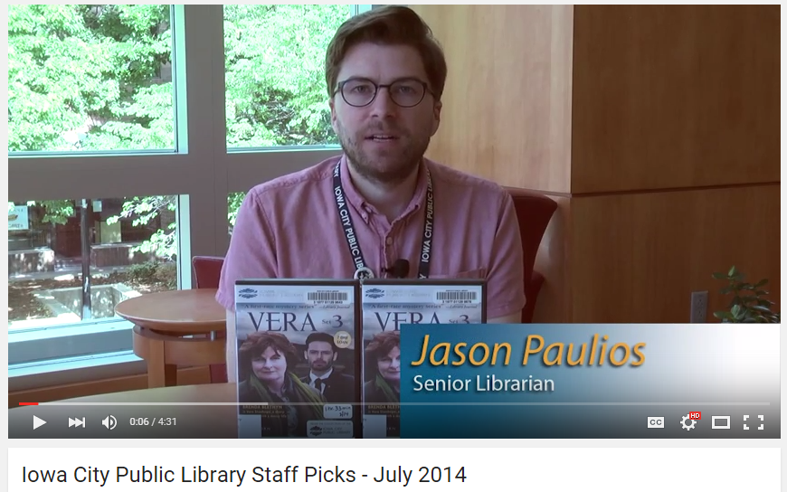
Who to Follow/Steal this idea
Iowa City Public Library – youtube.com/thelibrarychannel
The Mütter Museum – youtube.com/themuttermuseum
Notes:
Mutter minute
Guess what’s on the curator’s desk
Iowa City Public Library
The Mutter Museum
The Brain Scoop
Staxpeditions

Slide 20
Important Points and Advice
Notes:
Which leads to an important point, and something to keep in mind for today’s talk.
Social media is a great place to find an audience.
But the best place to find your audience may not be any particular social media site.
It may not be YOUR social media sites.
Should always be part of an overall strategy, working back and forth with traditional advertising, blogging, email marketing, paper newspapers, and more. There is no one place to reach everyone.
“I don’t have time”
Life is increasingly on/offline – (Pew stats).
It’s NOT an age thing. You have to want to have a conversation WITH the people there, or it will show.
Involve everyone. Give them a Role. Every Librarian is an outreach librarian. Successful social media involves everyone in some way. Processing is the best chance to find stuff.
Pick the best fit of audience/message so you get the most ROI. May NOT be your own channels.

Slide 21
Connecting to Locals?
Notes:
Locals are on Facebook and email.
But Facebook is problematic.
When we assess event attendance they see it in the paper newspaper, or respond to our postcard mailers.
If you want to measure social media success by event attendance, that may be a mismatch.
Choose goals that fit social media.

Slide 22
Most Popular Post Each Week Across ALL social media?
#tbt on Facebook
NOT on our site
Notes:
For example, our University Archivist is extremely active on social media, but does not post anything himself.
He has partnerships with the University to write a monthly “Old Gold” column for the alumni magazine that I share widely on social media.
He also selects content and writes one social media post a week that is our most popular weekly post, seen by the widest audience – and isn’t on our own channels. He makes a #tbt post that goes on the main University of Iowa Twitter, Instagram, and Facebook.

Slide 23
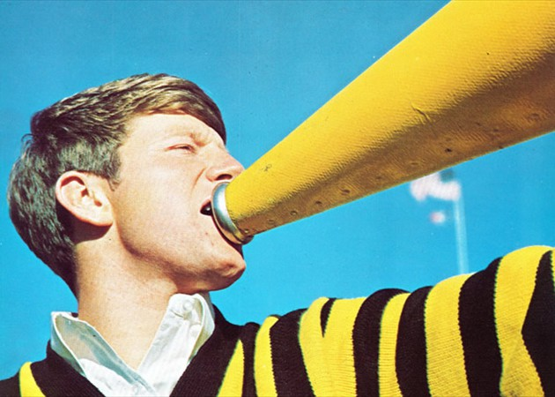
Organizing the Work: The Lone Voice
1969 Hawkeye Yearbook, University of Iowa Archives
Notes:
Working on social media alone has positives that you can use to your advantage, and challenges.
Consistent voice
Few barriers or conflict
Burnout is easy
Tips: Recruit help if you can in the form of volunteers, students, gradually incorporating any other staff, particularly if they are processing any historic materials, physical or digital – they have their eyes on the stuff.

Slide 24
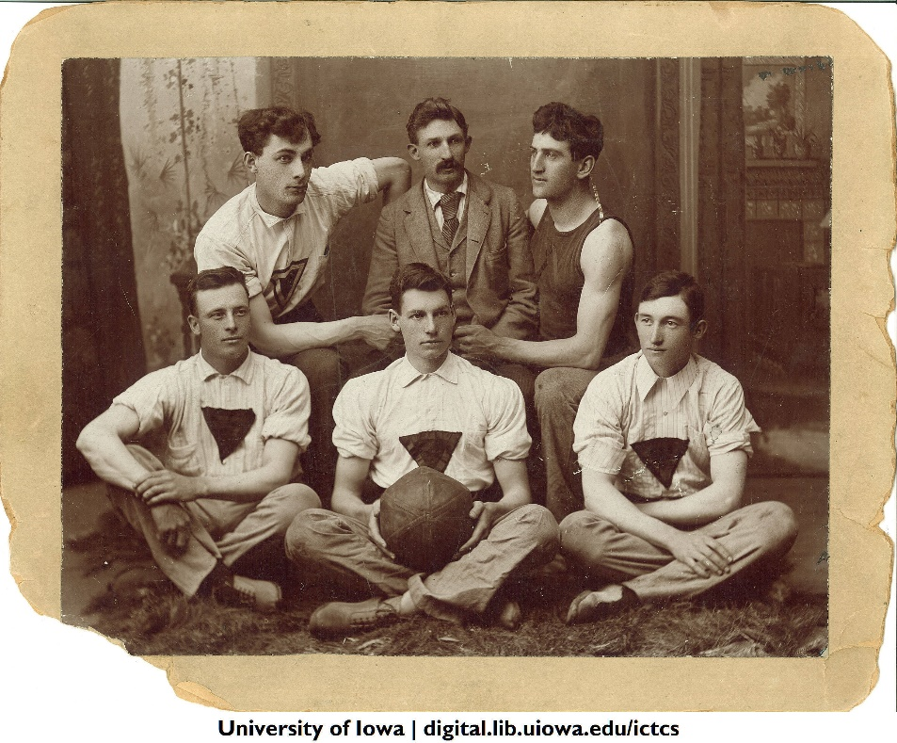
Coordinator + Content Creators
Basketball team with coach Henry Kallenberg, The University of Iowa, 1893-1894
Frederick Kent Collection, RG30.0001.001, University of Iowa Archives
Notes:
Coordinator/Coach plus team – UISpecColl “Find me the cool stuff.”
Coordinator: Voice, tags, collecting content from any volunteers or interns, reblogging & sharing to other sites. Design.
Pro:Easy to loop in others
Drawback: As it scales, manager doesn’t post as much (similar to management in general) Be willing to let others have the spotlight.
Easy to start, can harder to incorporate new folks into this existing model, if they are used to leading on their own
Advice: Manage the overall, but give people something, a theme, a social site, a topic, that they are responsible for on their own to avoid micromanaging and give trust

Slide 25
Working with Volunteers, Students and Interns
Whoever is processing is best
Volunteers can find items, take photos, write captions
Store photos and text in a document, send through email, create an online form
Create a teen advisory team
Retweet/reblog posts from public accounts
Notes:
Find support, or you will burn out.
Working with volunteers or students can be easy.
Teen advisory team.

Slide 26
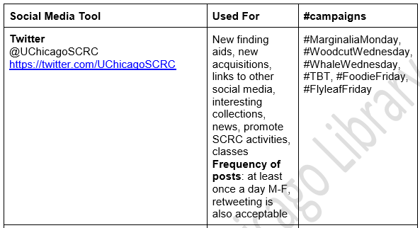
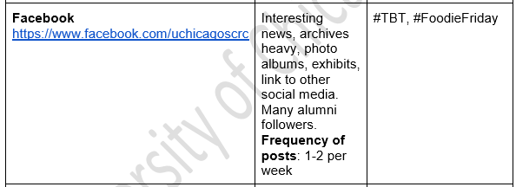
Social Media Matrix from Julia Gardner at the University of Chicago Library’s Special Collections Research Center
Notes:
Social Media Matrix from Julia Gardner Head of Reader Services
Special Collections Research Center
University of Chicago Library
1. Easy to start conversations with new contributors. Set expectations. Give guidelines about what fits where, all while being simple.

Slide 27
Volunteer Historic Research & Social Media Practicum
10 Hour Practicum
30 minutes finding aid training
Research anything you want in manuscript collections
Call up the boxes in the Reading Room
Read, explore, have fun
By the end of the 10 hours, submit a Word document with scans or photographs of 10 items with captions that tell something interesting about what it is or what caught your eye
Include full citations (Name and date of item, Manuscript Collection number, Box number, Folder number/name if applicable)
Notes:
Chase’s Calendar of Events – Use this month’s holidays to search the collections and find random things.
Create a mini-exhibit of three items that are part of a theme. Unusual creator, format, size, something that ties them together.
[-est items]

Slide 28
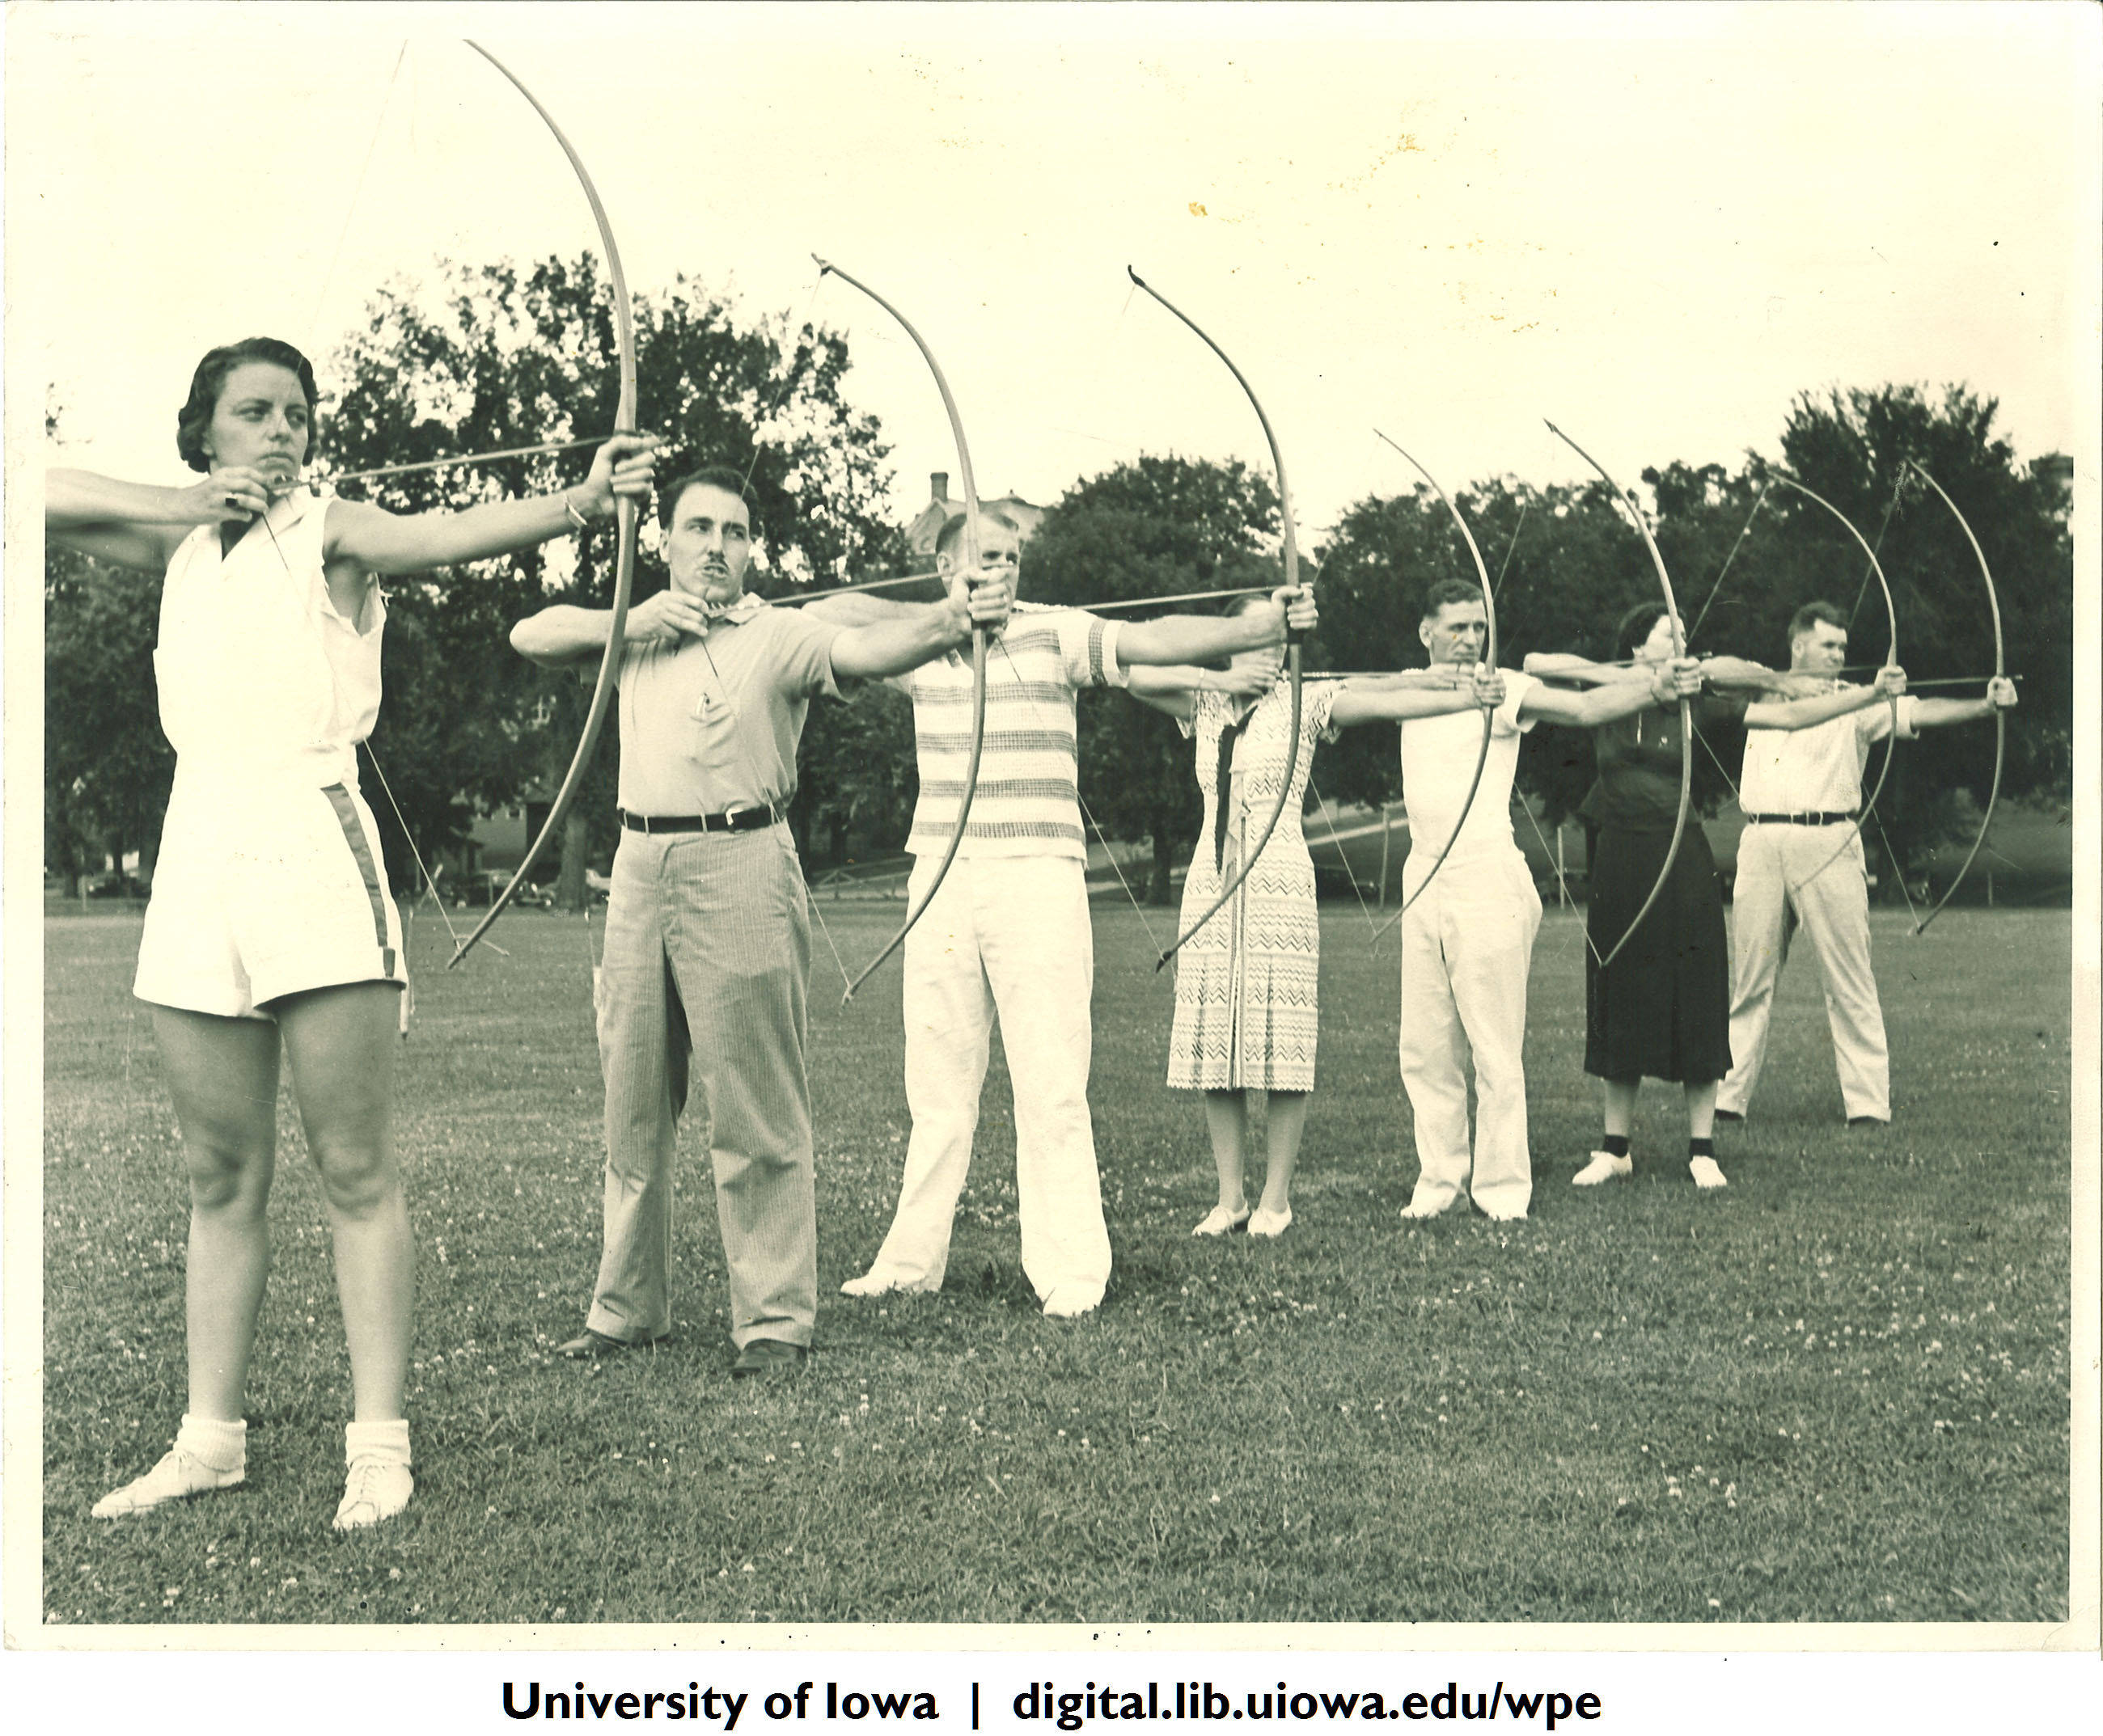
Individual Page Managers
The University of Iowa Department of Physical Education for Women Records, 1900-2006, IWA 106
Notes:
Especially useful if you can’t get along. Give someone their own space on one site and you do another.
Especially useful for subject specific pages.
Hevelin, Maps, IWA, and Iowa City Past.
“Personal Fifedoms”
Allows for followers to choose specific topics to follow, with a space where the whole identity can be seen.
Can also create a calendar, and assign everyone a day, once a month, once a week, once a semester.
Selected reblogs to the main page (hierarchy – identity can scale. Libraries – university – field)
Pros: Sense of ownership. Easy when you don’t have to share or coordinate.
Cons: Isolation leads to burnout. A single person WILL burnout, so this isn’t sustainable in the long run.

Slide 29
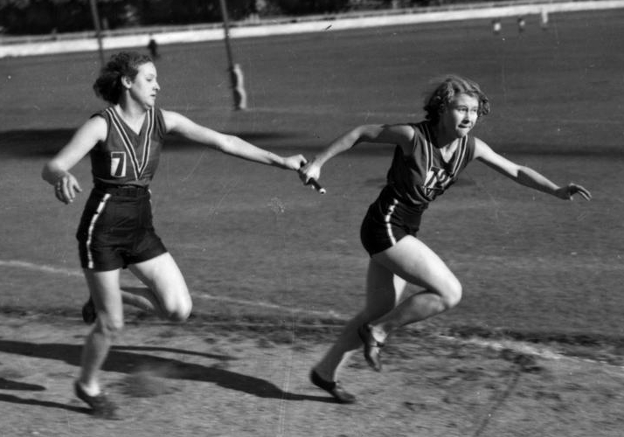
Trade Offs
Runners in a relay race, Brisbane, 1939 PD
Notes:
Scheduled posting or rebog responsibility: A week at time
Pro: Spreads the work. Can claim weeks that you know you won’t have major projects.
Con: Can be harder to maintain a consistent voice.

Slide 30
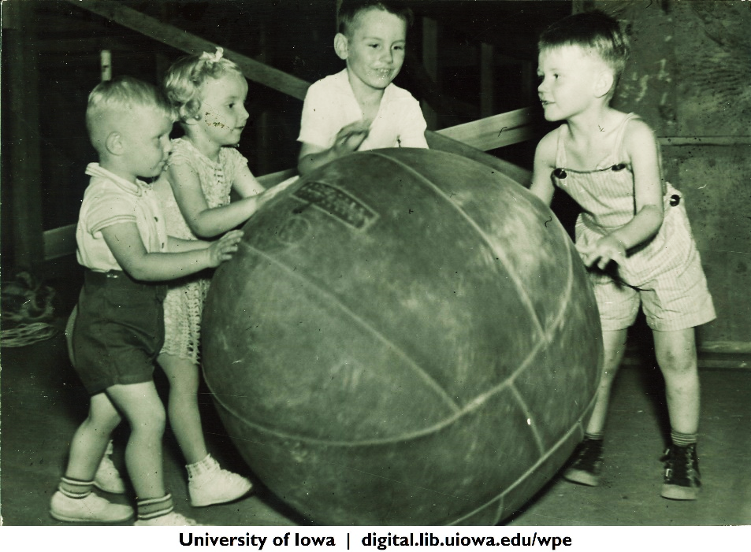
Student Led
The University of Iowa Department of Physical Education for Women Records, 1900-2006, Children’s Gym class, 1930s, IWA 106
Notes:
An in-between management strategy: University of Iowa Study Abroad recruits students to post to their own pages & pays a stipend or a device (their choice) for the semester. Requires a certain number of posts but about anything. Then selectively reblog. NOT US telling or controlling the story.
Biggest question: Post to your accounts, or reblog from theirs?
You cannot control the Internet. They will highlight things you think are stupid. They might say things “wrong.” They won’t speak as “experts.”They also know what people will like, especially if you are targeting undergrads or teens.

Slide 31
Coordinating
Monthly/weekly meeting
Content calendar for unique content
Use queues and management programs
Notes:
Monthly meeting.
Trainings.
Content calendar.
Weekly themes.
Hootsuite
Google Docs pros & cons.

Slide 32
Coordinating: What to Do at a Monthly Meeting
What has gone well, what has been challenging?
Questions/training/equipment needed?
What holidays are coming up? Any ideas for them?
Any ideas for new series? Assign or coordinate series work.
Put ideas on calendar, spreadsheet or Trello
Follow up about #2
ROTC meeting using map, The University of Iowa, 1919
Frederick Kent Collection, University of Iowa Archives
Notes:
What do you do at a monthly meeting?
What has gone well, what has been challenging?
Questions/training/equipment needed?
What holidays are coming up?
Plan Historic Content & Series.

Slide 33
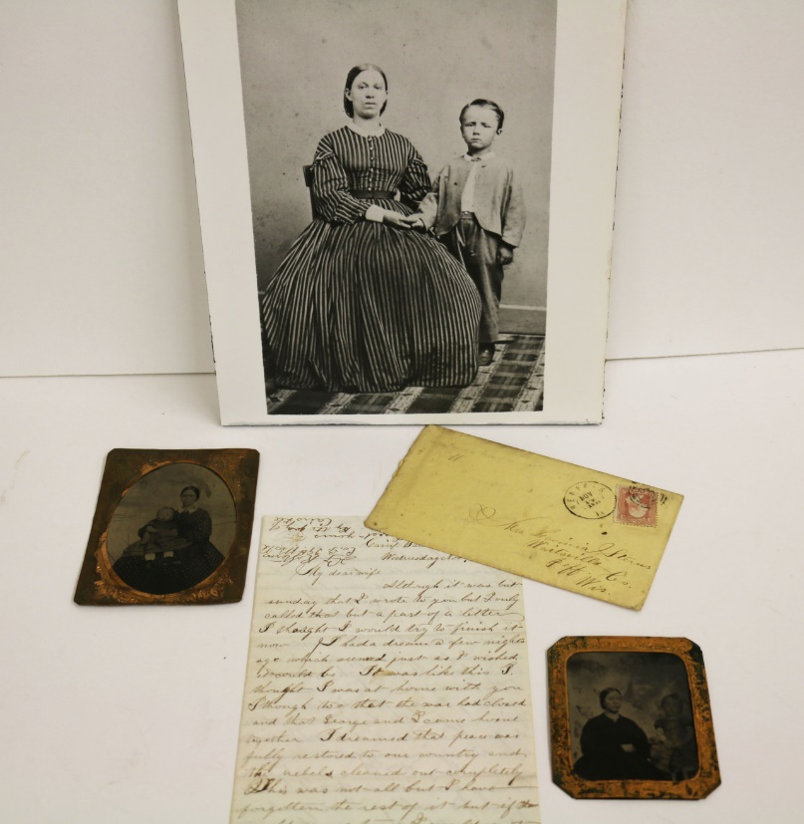
Coordinating: Series Content Saves Time
Series Content – Schedule time to finish 4-5 at once
Create a series that uses the same type or collection to reduce search time
#miniaturemondays on Tumblr
#sternsfamilypapers on Tumblr
Notes:
Rely on already digitized content. (Scan caveat)
Plan a day to photograph & scan a bunch at once.
Top 10 Miniature Mondays of 2014 at the end of the year. Announcement in weekly blog post about the social media series starting, and a recap of the series as its own post at the end.

Slide 34
Always Point to Your Social Media
Notes:
Point everything to everything else. Table tents with your social media. Brochures. Card to hand out with your sites.
Event hashtag, sign up for email. In the email, remind of your social media. On one social media site, remind them you’re on others.

Slide 35
Don’t Have New?
Sum it Up
Friday blog with most popular post
End of the month look back
End of the year summary
Top 10 lists, #oneyearago
University of Iowa Office of the State Archaeologist
http://iowaarchaeology.tumblr.com
Notes:
Reuse, sum up, repeat, reblog.
Tweet important things four times.
It will not be redundant. “Rule of Seven” Seven times before you take action.
Our blog (Stolen from Mizzou)
http://blog.lib.uiowa.edu/speccoll/2015/09/25/news-from-special-collections-919-9252015/

Slide 36
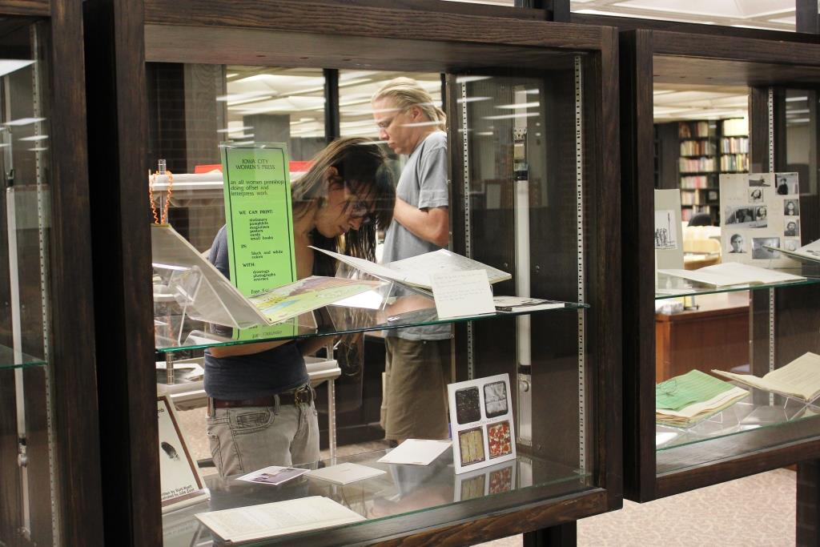
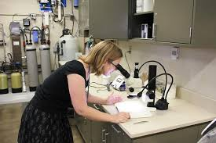
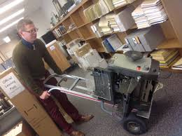
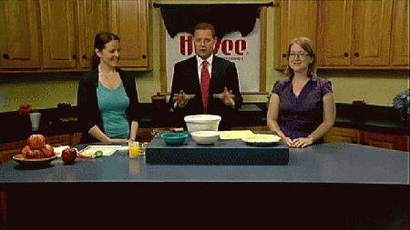
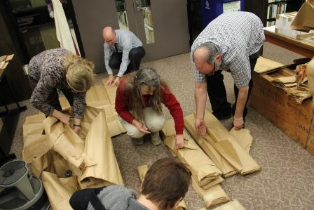
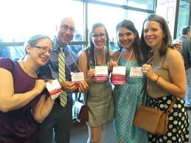
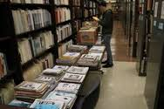
Show Behind the Scenes
#tumblr4sc
Notes:
We create our Voice by; Showing behind the scenes.
Which is also educating about what we do by showing.
Show behind the scenes
Work under your own name
Be seen as real people

Slide 37
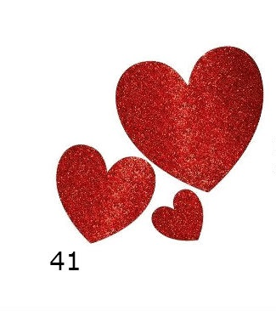
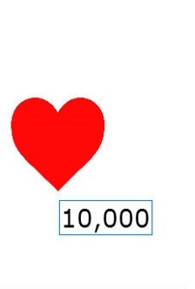
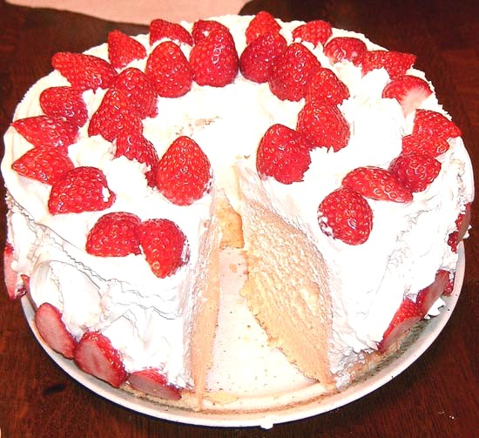
Advice Equations
=
Snp at Japanese Wikipedia
Notes:
Not all likes are equal
Balance “veggies and dessert”

Slide 38
How do I actually do this?
Do you have one of these?
Marck170601 Wikimedia Commons
Blake Patterson Wikimedia Commons
Notes:
Chicago shares one departmental iPad, logged into the accounts.

Slide 39
Next level:
Notes:
We’re using iPads, iPhones, but we also have a Canon (which one????)
We bought this because it was one of only a few cameras that had a microphone input, and we make a lot of video as well.
Difficult to use. But the auto setting makes you look like a professional. ☺

Slide 40
You May Want Some of These
Notes:
Lights
Think about the heat so therefore LED bulbs, never incandescent.
Color of your light.
If using iPhone/iPad you may not always want light. They expect your light to be cruddy and adjust for it. Filters.

Slide 41
Or Maybe One of These
Notes:
Packing tape, cardboard box, box cutter, white muslin or wax paper.
http://www.lynda.com/articles/photography-diy-light-box
http://www.wikihow.com/Create-an-Inexpensive-Photography-Lightbox
http://www.amazon.com/Neewer-50cmx70cm-Photography-Softbox-Universal/dp/B004KVJ3OE/ref=sr_1_3?s=photo&ie=UTF8&qid=1443292293&sr=1-3&keywords=photography+lights
$32.95 http://www.amazon.com/Cowboystudio-24-Inch-Photography-Studio-Light/dp/B003QA1VEK

Slide 42
How I Take Photos
Notes:
Need a photo

Slide 43
Equipment – Scanning
Notes:
Documents that are smaller than 8.5x11 are easy. You can scan them flat.
Bound materials are challenging.
Photos will take care of almost all needs except preservation quality images.
Most historic bound materials CANNOT be done safely without a cradle scanner.
Outsource. Crowdfund?

Slide 44
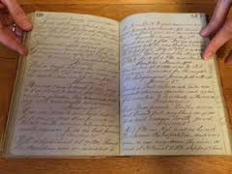
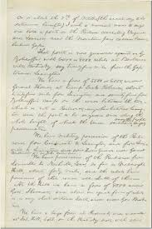
Why Photography?
This
Vs. This
Notes:
“object”ness
Size
Puts the person in the photo more – us delivering it. A service, a gift, going about our work.
Vicarious
When to photograph vs. when to scan?
Are you making a permanent collection item, or an ephemeral item, or both?
Either is fine, but decide consciously.

Slide 45
Digitization
Workflow and metadata plan:
List of future projects, prioritized and/or assigned
Condition assessment
Conserve or wait to outsource
File format plan, storage location plan
Metadata plan
Handling plan
Digitize
Write metadata
Back up copy – store in a different location
Provide access (KEY)
600 dpi
.tiff
Notes:
You Asked for This So I Included It
Ideal – 600dpi Tiff. Scan and downsize?
Choose a naming convention and use it consistently.
Multiple copies in different geographic locations.
Servers.
Hard drives.
Have a community scan day and keep a copy.

Slide 46
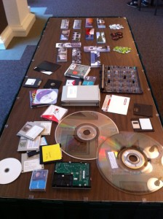
Preservation Advocacy
Make posts about obsolete formats
Have events to digitize local photos
Bring in local cultural heritage folks for “Caring for Keepsakes”
Brochures
Selection of obsolete media at the 2010 National Book Festival, by wlef70, on Flickr
Notes:
Digital infrastructure is invisible – difficult. Advocate.
Caring for Keepsakes –
Gaylord brochures.
Preservation Week

Slide 47
What Do I Do With the Photos or Scans? Have You Used One of These?
Next Level: Adobe Creative Suite [Photoshop]
Notes:
Gimp and Picasa for editing
Canva for adding graphic design text type stuff

Slide 48
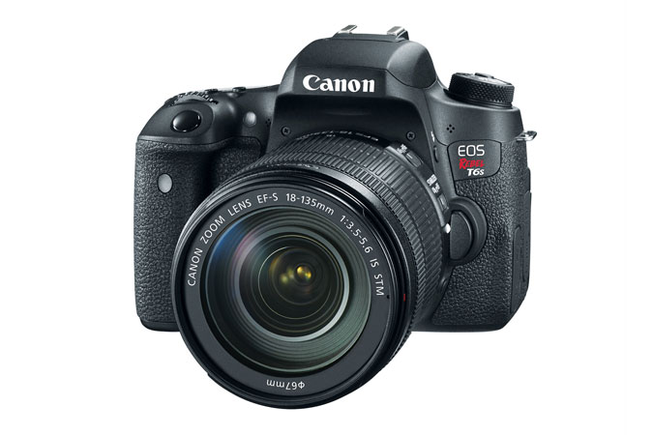
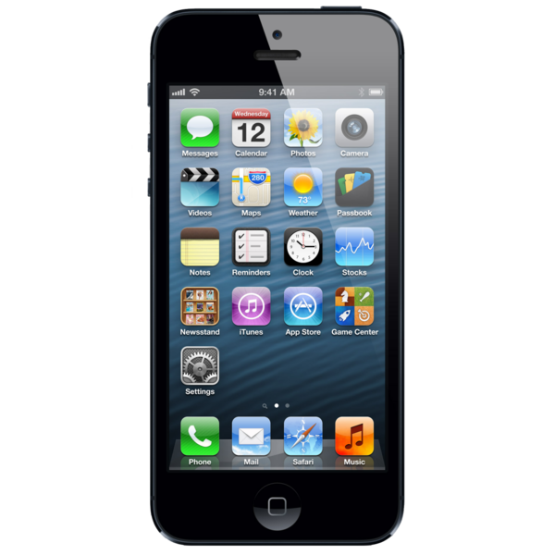
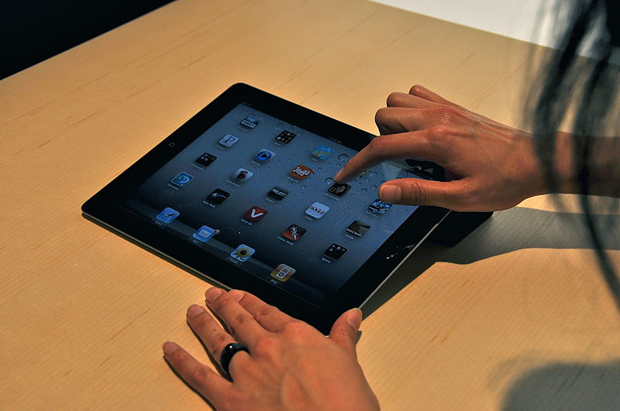
Equipment - Video
*Having a microphone is helpful

Slide 49
Editing Video: Have You Used One of These?
] Next Level: Adobe Creative Suite [Premiere & After Effects]
Notes:
YouTube’s Creator Studio: YouTube’s built in editor’s (Great for video clips, CC licensed music. Add photos. Extremely limited sound editing, fade out would be appreciated)
[Side note: Great one to teach]
iMovie for iPad or Mac.
Don’t use Movie Maker.
Advanced: Adobe Premiere
Google everything with “tutorial”

Slide 50
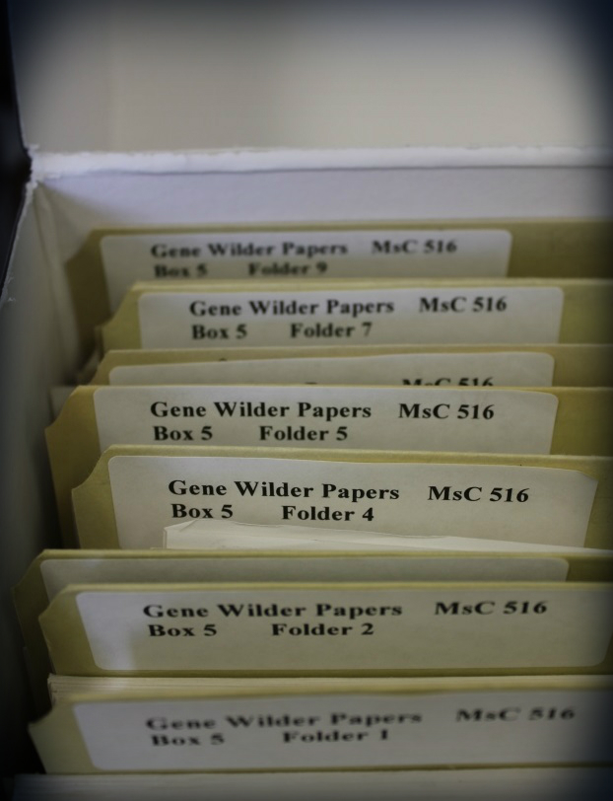
Collections Care and Handling
Box items when possible
Wash your hands
Avoid lotion
Keep food and drinks away
Keep materials out of the light (especially fluorescent light)
Climate control – reduce humidity fluctuation
Store on an upper floor, not a basement, whenever possible
Off the floor, at least on pallets

Slide 51
Handling - photographs
Carl Van Tuyl Collection of Miniature Photographs of SUI Campus ca. 1920.
http://www.loc.gov/preservation/care/photo.html
Notes:
White gloves
When possible, clear enclosures mylar/polypropelene – allows the item to be seen on both sides without handling, but, can be pricey.
Color are the most unstable – prioritize digitization or cold storage

Slide 52
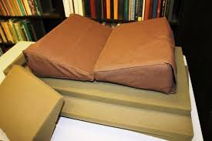
Handling – Bound materials
Notes:
Cradles – sew your own.
Use pillows, rolled up and taped newspaper.
Anything to keep the book about a 90 degree angle.

Slide 53
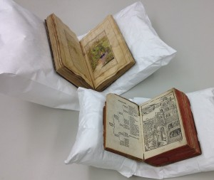
DIY Book Cradle
By Jana Dambrogio
http://libraries.mit.edu/news/inexpensive-cradle/16788/
Notes:
When in doubt – start a list of items that need help.
Make that a social media series.
Adopt a book.
Fundraising to save an item.
Crowdsource digitization.
Use for preservation outreach.

Slide 54
A Note on White Gloves
Notes:
I take these objections as our sign of a really successful post.
It has moved beyond our usual audience into non-book people.

Slide 55
Getting Started When Faced with Skepticism
Partner with a larger channel/intersecting identity
Make weekly/monthly content
Build audience & Demonstrate value
Later, start your own
Have partner help advertise your new channel
Notes:
Iowa City Downtown District
Pentacrest Museum
Iowa City Public Library
Octoberfest – Historic Foodies, History of the beer caves, beer riots
Churches
Amana Colonies

Slide 56
Example #1: Iowa City Public Library
Digital History Project
Iowa City Past Tumblr – partnership with the University of Iowa Digital Library (iowacitypast.tumblr.com)
Local History video channel for recorded talks
Irving B. Weber Days
Exhibits
Notes:
Biggest question: Post to your accounts, or reblog from theirs?

Slide 57
Example #2: Denver Public Library: Creating Your Community
IMLS Grant funded project
Focus on local neighborhoods
Notes:
Aurora History Museum, Auraria Library, Blair-Caldwell African American Research Library, Colorado Genealogical Society, Douglas County Research Center, Four-Mile Historic Park, History Colorado, Historic Denver, Ira M. and Peryle Hayutin Beck Memorial Archives of Rocky Mountain Jewish History, Penrose Library at the University of Denver, Lakewood Heritage Center, Zion Baptist Church and made possible by a grant from the Institute of Museum and Library Services (IMLS).
Seven neighborhoods, scanning and preservation events in community centers
Community Tuesdays: Dogs of the neighborhoods, Halloween costumes, Pridefest, Park Stories, Free USB drives

Slide 58
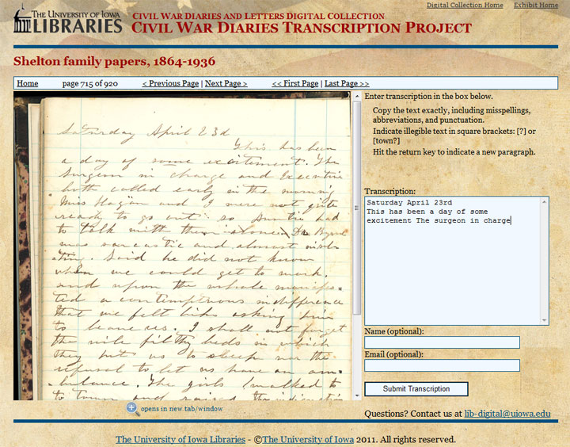
Example #3: University of Iowa Libraries DIY History
Began with only 2-3 people working on it
Image + Email form
Notes:
Civil War Crowdsourcing
Omeka website with scripto plugin, and Twitter
Tweet short quotes from that day in history
Picked up by Reddit, brought the site down.
Reinforced, ran out of content.
Had to expand to others – culinary manuscripts, Iowa Pioneer women’s diaries, Nile Kinnick, Railroads,
Historic Foodies, historic foodies group led to partnership with Octoberfest and local chefs
Partnership between UISpecial Collections, Digitial Scholarship and Publishing Studio, and Preservation/Conservation
Takeaway: Put up individual documents and ask for transcription help. People have fun with it.

Slide 59
Resources
ALA ThinkTank
Library Marketing and Outreach
The Shareable Clique
Libraries and Social Media
Social Media for Special Collections

Slide 60
Questions?
Colleen Theisen
Outreach & Instruction Librarian
Special Collections
University of Iowa
@libralthinking
@uispeccoll
Amateur photographer's club in front of library,
Physics Building, The University of Iowa, 1888

