Slide 1



Slide 2
Meet Our Facilitators
Yesenia Lopez
Luisa Martucci
Nelida Vazquez

Slide 3
What we won’t learn here:
Complex Grammar
Advanced Vocabulary
Fluent conversation skills
Every colloquial expression for every dialect of Spanish

Slide 4
What we will learn here:
Basic conversational phrases
Essential Grammar for everyday situations
Variations in pronunciation or slang used in different Spanish-speaking countries.
Cultural insights

Slide 5
Spanish Language: Things to Know
Spanish is the majority language in 21 countries, and a commonly used language in many more
Many dialects, accents, and variations in vocabulary
“Spanglish” can make for even more variation

Slide 6
Getting Started:
Introduction of ourselves in Spanish
Spanish alphabet practice-Tips
Review Vocabulary :Library Cards and Simple Documents
Listening and practice Pronunciation
Role Playing.

Slide 7
INTRODUCTION:
Hola, me llamo ________________
(Hi, my name is ________________)
Trabajo en ____________________
(I work at _____________________)
Mi color favorito es _________________
(my favorite color is_________________)

Slide 8
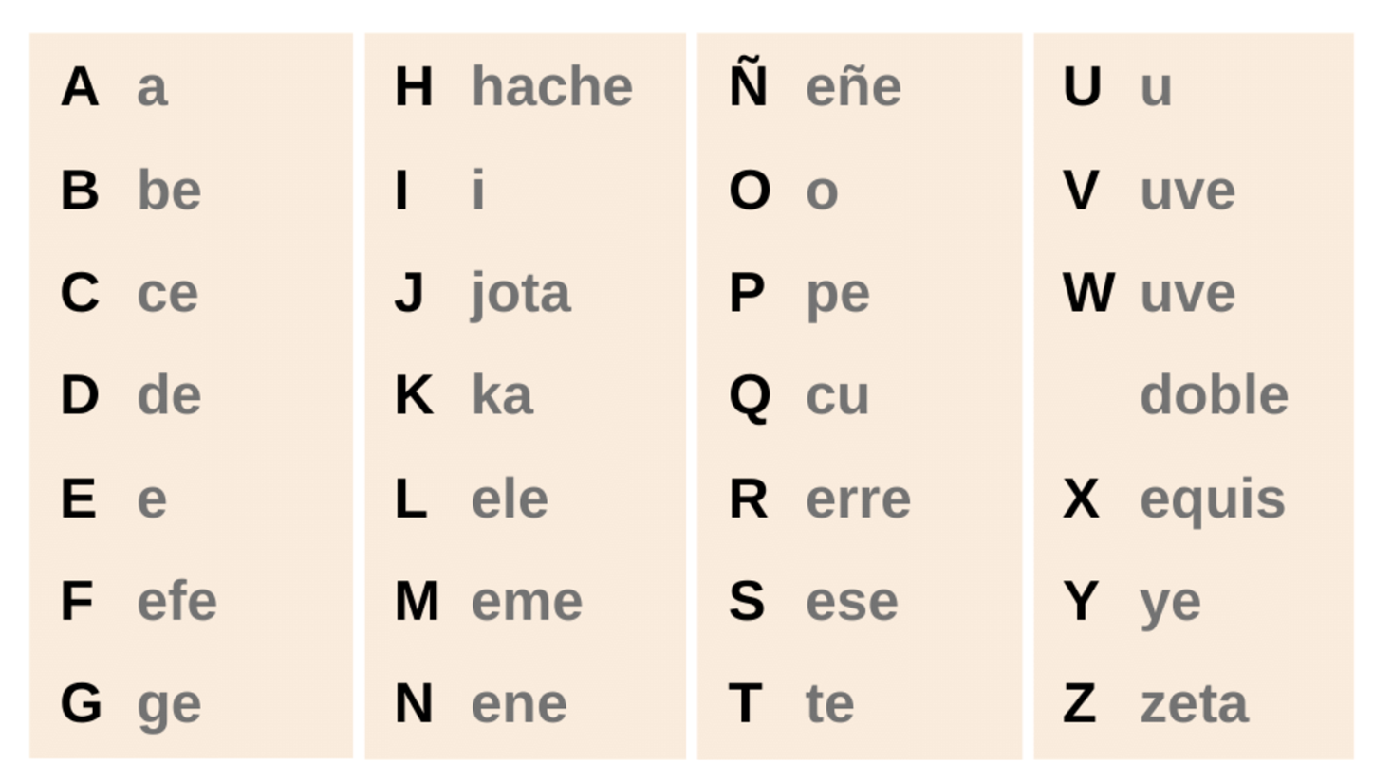
Pronouncing the Spanish Alphabet
Notes:
Warm up pronouncuation

Slide 9
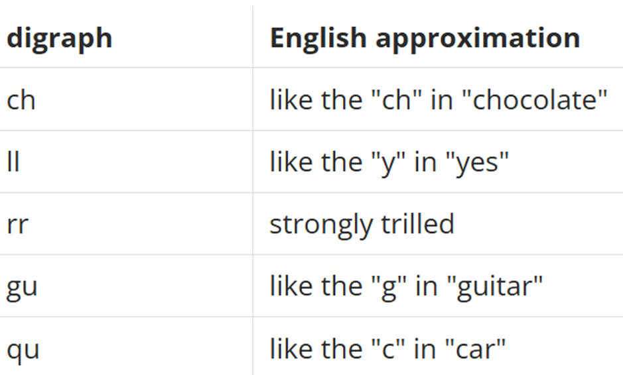
Pronunciation Tips:
Diagraf
Ch ( che) = chao (bye)
LL ( elle) = llave (key)
rr (erre) = carro (car)
Gu (geu) = gustar (like)
Qu (ku) = queso (cheese)
Notes:
Warm up pronouncuation

Slide 10
Vocabulary List 3: Library Cards and Simple Documents
I will first present the pronunciation then offer volunteers the opportunity to pronounce the Spanish vocabulary.
Break down vocabulary and practice the different uses of vocabulary.
Notes:
Explain better

Slide 11

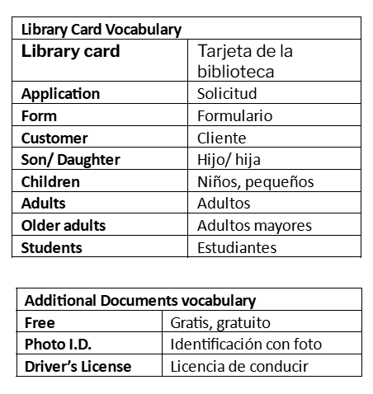
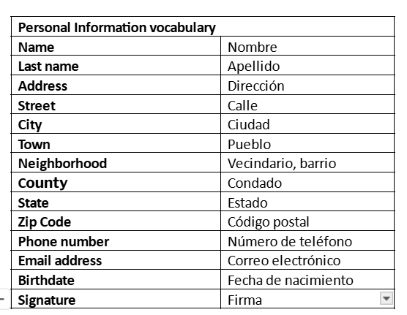
Library Card Vocabulary
Notes:
Add phrases?

Slide 12

Librarian=
How can I help you?
¿Como te puedo ayudar?
Patron=
Necesito un libro para mis hijos. (I need a book for my children.)
¿Donde esta el baño? (Where is the bathroom?)
¿Tienes impresora? (Do you have a printer?)
Librarian=
A. La sesión de los niños esta… (The children's section is…)
B. El baño esta enseguida de… (The bathroom is next to…)
C. Si, esta enseguida de.. (Yes, it is next to…)

Slide 13
Librarian=
Do you have a library card?
¿Tiene una tarjeta de la biblioteca?
Patron=
No, tengo. (No, I don’t have one.)
Si, tengo. (Yes, I have one.)
Necesito una tarjeta de la biblioteca, por favor. (I need a Library card, please.)
Librarian=
Would you like to get one? ¿Le gustaría obtener una?

Slide 14
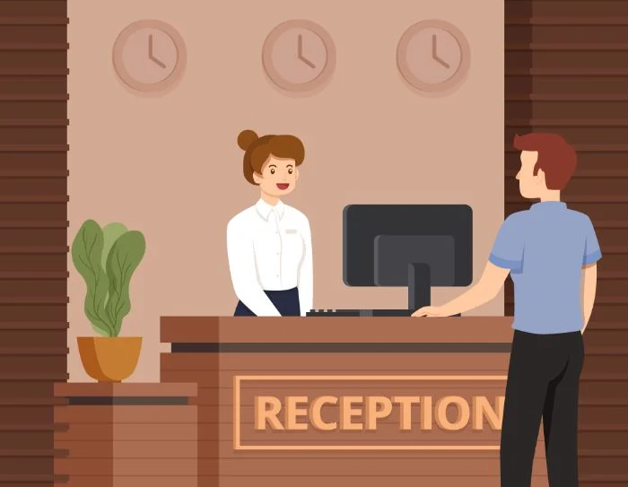
Notes:
Listening Practice

Slide 15
More Vocabulary!
“Wh” Questions
"¿Qué?" (what),
"¿Quién?" (who),
"¿Dónde?" (where),
"¿Cuándo?" (when),
"¿Por qué?" (why),
"¿Cómo?" (how),
"¿Cuál?" (which),
"¿Cuánto/Cuántos?" (how much/how many)
“To have”
Tener
“Yo” (I) tengo
“Tú” ( you) tienes
“él, ella, usted” (he, she, you) tiene
“Nosotros” (we) tenemos
“ellos, ellas, ustedes” (they) tienen
Notes:
Key Points of WH questions and Verb To be

Slide 16
Patron=
- ¿Qué tengo que hacer para optener una tarjeta de la biblioteca?
What do I have to do to get a library card?
Librarian=
- Por favor, llene este formulario. - ¿Tienes identificación con foto?
Please fill out this form. Do you have Photo ID?
Librarian=
- ¿Cuál es tu dirección? - ¿Cuántos hijos tienes?
What is your address? How many kids do you have?
Patron=
-Mi dirección es…. - Yo tengo 3 hijos
My address is… I have 3 kids
Notes:
Examples

Slide 17

Questions?

Slide 18
Practice: Role Playing
I will demonstrate first, and then you will break into pairs to work with your partner in your own script and practice
Participants will be divided into groups of 3 to 4 people, and you will have 15-20 minutes to practice.
I will join each group to answer questions

Slide 19
Example Role-Playing
(Library Worker & Patron)
1. Librarian=
Buenos días, Como le puedo ayudar?
2. Patron=
Hola, Gracias!
¿Tiene una computadora disponible?
Necesito descargar un documento.
3. Librarian=
Disculpe, mas despacio por favor
4. Patron=
Tiene una computadora disponible?
Necesito descargar un documento.
5. Librarian=
Si, la sala de computadores esta atras
6. Patron=
Gracias!
Notes:
Example

