Slide 1



Slide 2
Meet Our Facilitators
Yesenia Lopez
Luisa Martucci
Nelida Vazquez

Slide 3
What we won’t learn here:
Complex Grammar
Advanced Vocabulary
Fluent conversation skills
Every colloquial expression for every dialect of Spanish

Slide 4
What we will learn here:
Basic conversational phrases
Essential Grammar for everyday situations
Variations in pronunciation or slang used in different Spanish-speaking countries.
Cultural insights

Slide 5
Spanish Language: Things to Know
Spanish is the majority language in 21 countries, and a commonly used language in many more
Many dialects, accents, and variations in vocabulary
“Spanglish” can make for even more variation

Slide 6
Getting Started:
Introduction of ourselves in Spanish
Spanish alphabet practice- Tips
Review Vocabulary: Reference
Listen and comprehend phrases
Practice through a Role Play

Slide 7
INTRODUCTION:
Hola, me llamo ________________
(Hi, my name is ________________)
Trabajo en ____________________
(I work at _____________________)
Mi color favorito es _________________
(my favorite color is_________________)

Slide 8
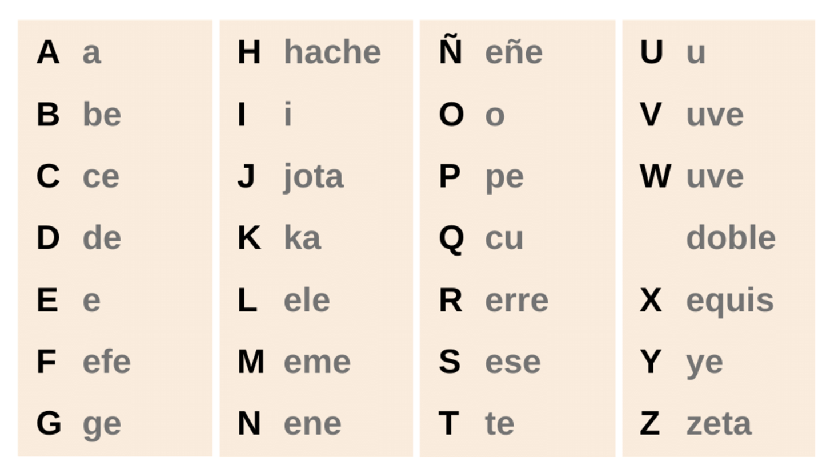
Pronouncing the Spanish Alphabet
Notes:
Warm up pronouncuation

Slide 9
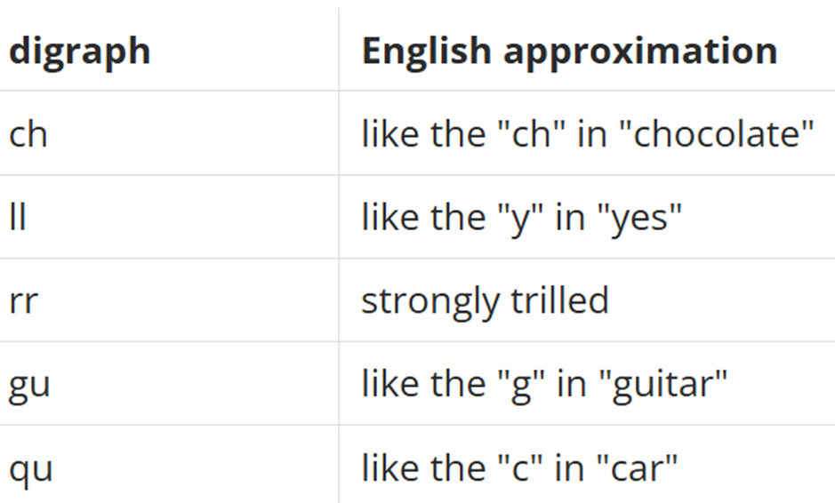
Pronunciation Tips:
Diagraf
Ch ( che) = chao (bye)
LL ( elle) = llave (key)
rr (erre) = carro (car)
Gu (geu) = gustar (like)
Qu (ku) = queso (cheese)
Notes:
Warm up pronouncuation

Slide 10
Vocabulary List 5: Reference
I will first present the pronunciation.
Participants will have the opportunity to pronounce the Spanish vocabulary in their own.
We will practice vocabulary throght Matamoscas / Fly swatter game.
Notes:
Explain better

Slide 11
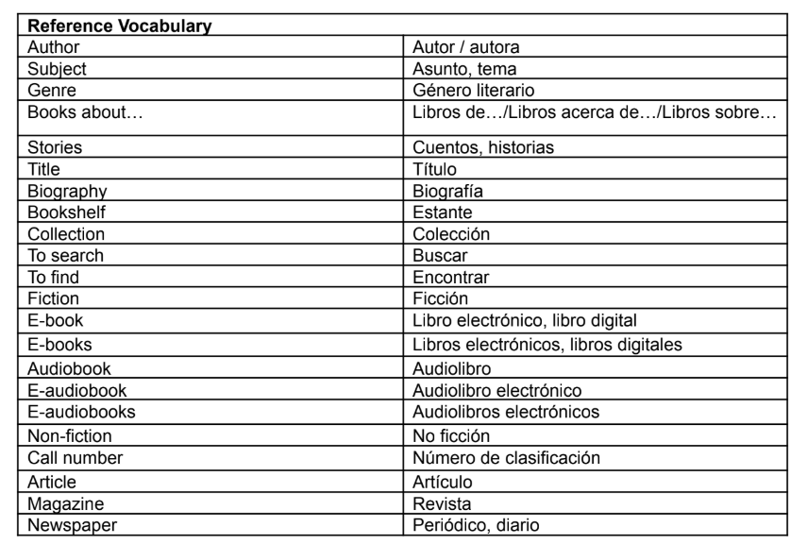
Vocabulary List 5: Reference
Notes:
Add phrases?

Slide 12
​
Programs and Events Vocabulary practice
Matamoscas / Fly swatter
Autor (a)
Articulo
Bucar
Encontar
Cuentos/ historias
Asunto
No ficction
Estante
Ficcion
Coleccion
periodico/diario
Biografia
revista
Libros acerca de...
Numero de clasificacion
Audiolibro
Titulo
Genero literario

Slide 13
Phrases: Reference Vocabulary
I will first present the pronunciation of phrases
Participants will have the opportunity to pronounce the Spanish vocabulary in their own.
I will play a video we will discuss multiple interactions happening at the library.
Notes:
Explain better

Slide 14
Reference Phrases
How can I help you?
¿Cómo puedo ayudarle?
I’m looking for books about citizenship.
Estoy buscando libros de la ciudadanía.
Do you have any books in Spanish?
¿Tiene algunos libros en español?
Where are the books to learn English?
¿Dónde están los libros para aprender inglés?
Follow me, please.
Sígame, por favor.

Slide 15
One moment, please.
Un momento, por favor.
How can I reserve this book?
¿Cómo puedo reservar este libro?
Hello, what time does the library open?
¿Hola, a que hora abre la biblioteca? = a las 8am...
How to register at the library?
¿como inscribirse en la biblioteca?
To get a library card you need...
para obtener la tarjeta de la biblioteca necesitas...
I'm looking for a book about...
Estoy buscando un libro sobre...
Where can I consult the catalog?
¿Donde puedo consultar el catalogo?

Slide 16
Reference Vocabulary use
​Listen carefully to Dialogue at the Library

Slide 17

Listen carefully and try to answer!

Slide 18
Posible answers
Notes:
Key Points of WH questions and Verb To be

Slide 19
Listen carefully and try to answer!
Notes:
Key Points of WH questions and Verb To be

Slide 20
Posible answers
Notes:
Key Points of WH questions and Verb To be

Slide 21
Listen carefully and try to answer!
Notes:
Key Points of WH questions and Verb To be

Slide 22
Posible answers
Notes:
Key Points of WH questions and Verb To be

Slide 23
Listen carefully and try to answer!
Notes:
Key Points of WH questions and Verb To be

Slide 24
Posible answers
Notes:
Key Points of WH questions and Verb To be

Slide 25

Questions?

Slide 26
Practice: Role Playing
Participants will be divided into groups of 3 to 4 people, and you will have 15 minutes to practice possible scenarios with a patron.
We will visit each room and answer questions.
Share the practice with the whole group.

Slide 27
¡Gracias!

