Slide 1
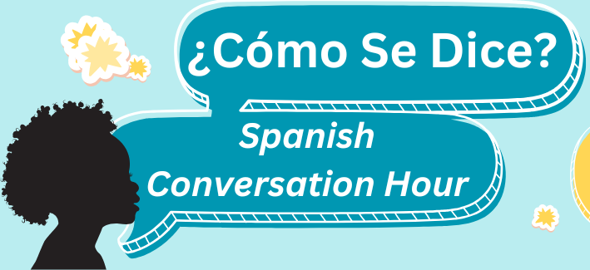


Slide 2
Meet Our Facilitators
Yesenia Lopez
Luisa Martucci
Nelida Vazquez

Slide 3
What we won’t learn here:
Complex Grammar
Advanced Vocabulary
Fluent conversation skills
Every colloquial expression for every dialect of Spanish

Slide 4
What we will learn here:
Basic conversational phrases
Essential Grammar for everyday situations
Variations in pronunciation or slang used in differents spanish-speaking countries.
Cultural insights

Slide 5
Spanish Language: Things to Know
Spanish is the majority language in 21 countries, and a commonly used language in many more
Many dialects, accents, and variations in vocabulary
“Spanglish” can make for even more variation

Slide 6
Getting Started:
Introduction of ourselves in spanish
Spanish alphabet practice
Pronunciation tips

Slide 7
INTRODUCTION:
Hola, me llamo ________________
(Hi, my name is ________________)
Trabajo en ____________________
(I work at _____________________)
Mi color favorito es _________________
(my favorite color is_________________)

Slide 8
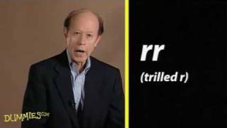
ALPHABET

Slide 9
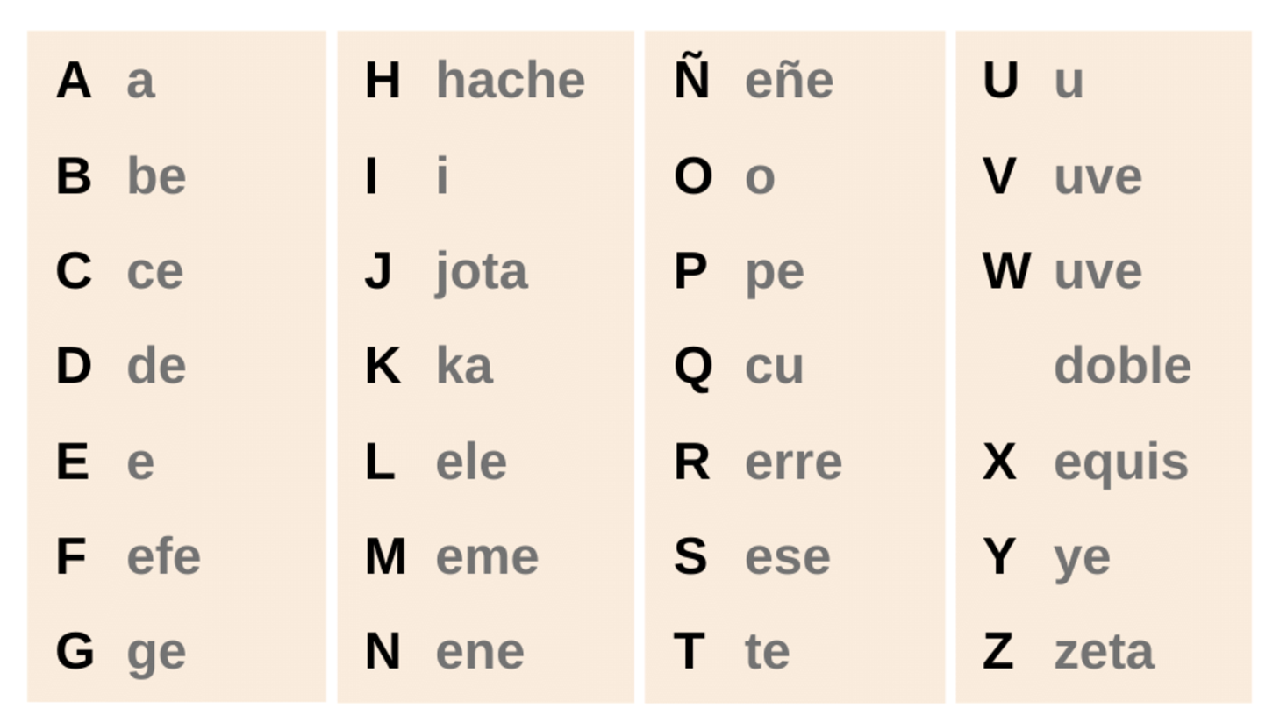
Pronouncing the Spanish Alphabet

Slide 10
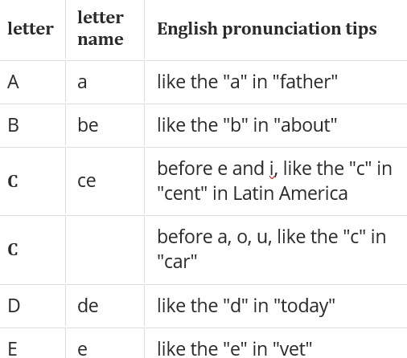
Pronunciation Tips
A = Ayuda (Help)
B = Burro (donkey)
C = Cero (Zero)
C = Casa (house)
D = dia (day)
E = Español (Spanish)

Slide 11
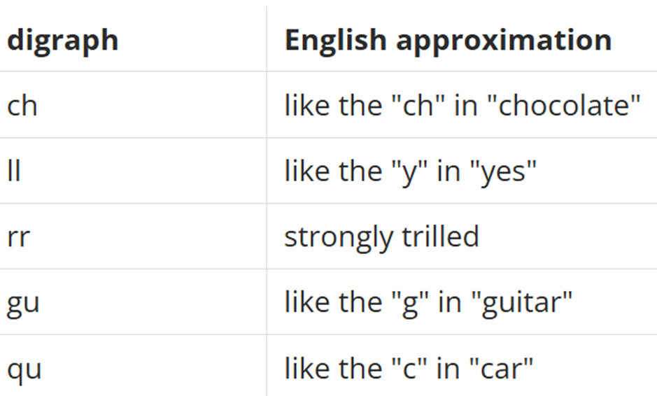
Digraph
Ch ( che) = chao (bye)
LL ( elle) = llave (key)
rr (erre) = carro (car)
Gu (geu) = gustar (like)
Qu (ku) = queso (cheese)

Slide 12
Vocab Lists
Session 1: Welcome & Customer Service
Session 2: Circulation
Session 3: Library Cards and Simple Documents
Session 4: Programs & Events
Session 5: Reference
Session 6: Technology

Slide 13
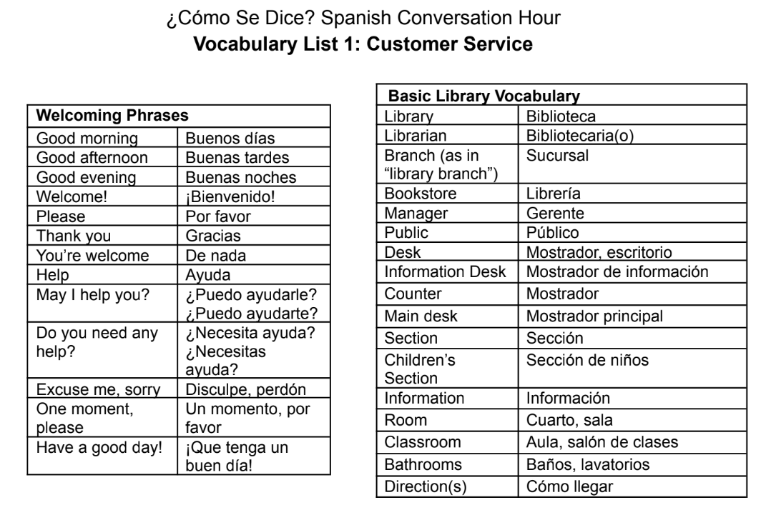

Slide 14

Questions?

Slide 15
Practice: Role-Playing
We will demonstrate first, and then you will break into pairs to work with your partner in breakout rooms.
We will come together and share after

Slide 16
Example Conversation:
Library worker: -Good Morning
Patron: -Buenos días
Library worker: -¿Habla inglés?
Patron: - Lo siento. No hablo inglés.
Library worker: Hablo solo un poco de español.
Más despacio, por favor.
Patron: Gracias!
- El baño por favor

Slide 17
